Slide 1

Modern Control Presentation Parsa Ghadimi 810199468

Slide 2
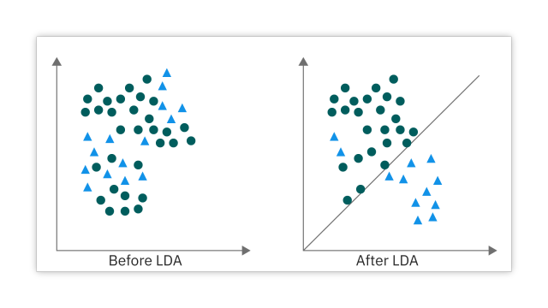
Subject : Dimension Reduction Algorithms (LDA*)

Slide 3
Why Do We Need Dimension Reduction Techniques?
1)High-dimensional data is difficult to visualize
2) High-dimensional data requires more computational resources and time to process and analyze
3) Dimensionality reduction helps in identifying the most relevant features or variables that contribute the most to the target variable
4) High-dimensional data increases the risk of overfitting
5)etc.

Slide 4
Some Dimension Reduction Algorithms
1)LDA
2)PCA
3)SVD
4)FA
5)etc.

Slide 5
LDA
LDA stands for : Linear Discriminant Analysis
LDA is primarily used for supervised classification problems
LDA goal : project the data onto a lower-dimensional space while preserving the class discrimination information as much as possible.

Slide 6
How Dose LDA Work?
Matrix derivation: LDA constructs two scatter matrices: the within-class scatter matrix (Sw) and the between-class scatter matrix (Sb).
Combined scatter matrix: To obtain a single matrix for eigenvalue decomposition, LDA taking the product of the inverse of the within-class scatter matrix (Sw^(-1)) and the between-class scatter matrix (Sb).
Eigenvalues and eigenvectors: Eigenvalue decomposition is then performed on the matrix. The resulting eigenvalues represent the importance or significance of the corresponding eigenvectors. While the eigenvectors are vectors that define the directions in the lower-dimensional space.

Slide 7
Sorting eigenvalues and eigenvectors: The eigenvalues are typically sorted in descending order, indicating the relative importance of the corresponding eigenvectors. The eigenvector corresponding to the largest eigenvalue represents the primary direction of the projection, which maximizes the separation between classes.
Projection directions: The eigenvectors obtained from eigenvalue decomposition serve as the projection directions in the lower-dimensional space.
Dimensionality reduction: The number of eigenvectors chosen for the projection depends on the desired dimensionality of the reduced space.

Slide 8
LDA Applications
Classification problems
Face recognition: LDA has been successfully used in face recognition tasks. By projecting face images onto a lower-dimensional space using LDA, the resulting features can capture the essential facial characteristics and enhance the discrimination between different individuals.
Text classification
Feature selection and extraction
Data visualization
Preprocessing
Etc.

Slide 9
LDA Advantages And Limits
Advantages :
Preservation of class separability
Interpretability
Supervised
Limits :
Linearity assumption
Equal covariance assumption: LDA assumes that the classes have equal covariance matrices
Limited to linear transformations: LDA can only capture linear relationships between variables.

Slide 10
Advancements And Extensions To LDA
Regularized LDA (rLDA)
Flexible Discriminant Analysis (FDA)
Kernel Discriminant Analysis (KDA)
Local Fisher Discriminant Analysis (LFDA)
Etc

